Slide 1
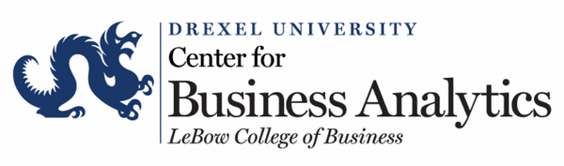







The Impact of COVID-19 on The Retail Sector
Team: Data Dragon
An Ngo | Andrea Ngo | Justin Nguyen
Medhavi Jain | Tram Le | Zion Taber

Slide 2
Agenda
I. EXECUTIVE SUMMARY & DATA OVERVIEW
II. DATA EXPLORATION
III. DATA ANALYSIS
IV. CASE STUDY
V. RESULTS & RECOMMENDATION

Slide 3
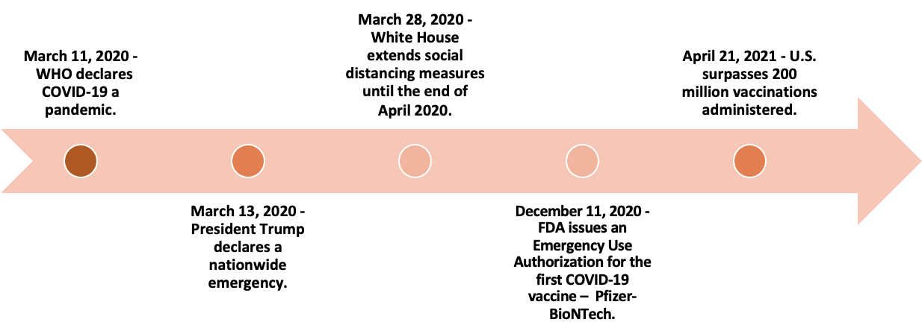
Executive Summary
It would be hard to overstate the ever-evolving effects of the COVID-19 pandemic on the retail industry.
Lockdown orders, supply chain issues, an accelerated push towards e-commerce, and consumers hoarding were just a few of the hurdle's retailers have had to face. Despite of these challenges, individual companies within the retail industry were able to perform well and even thrive during the pandemic.
We set out to determine what factors separated the high performers from those that struggled.

Slide 4
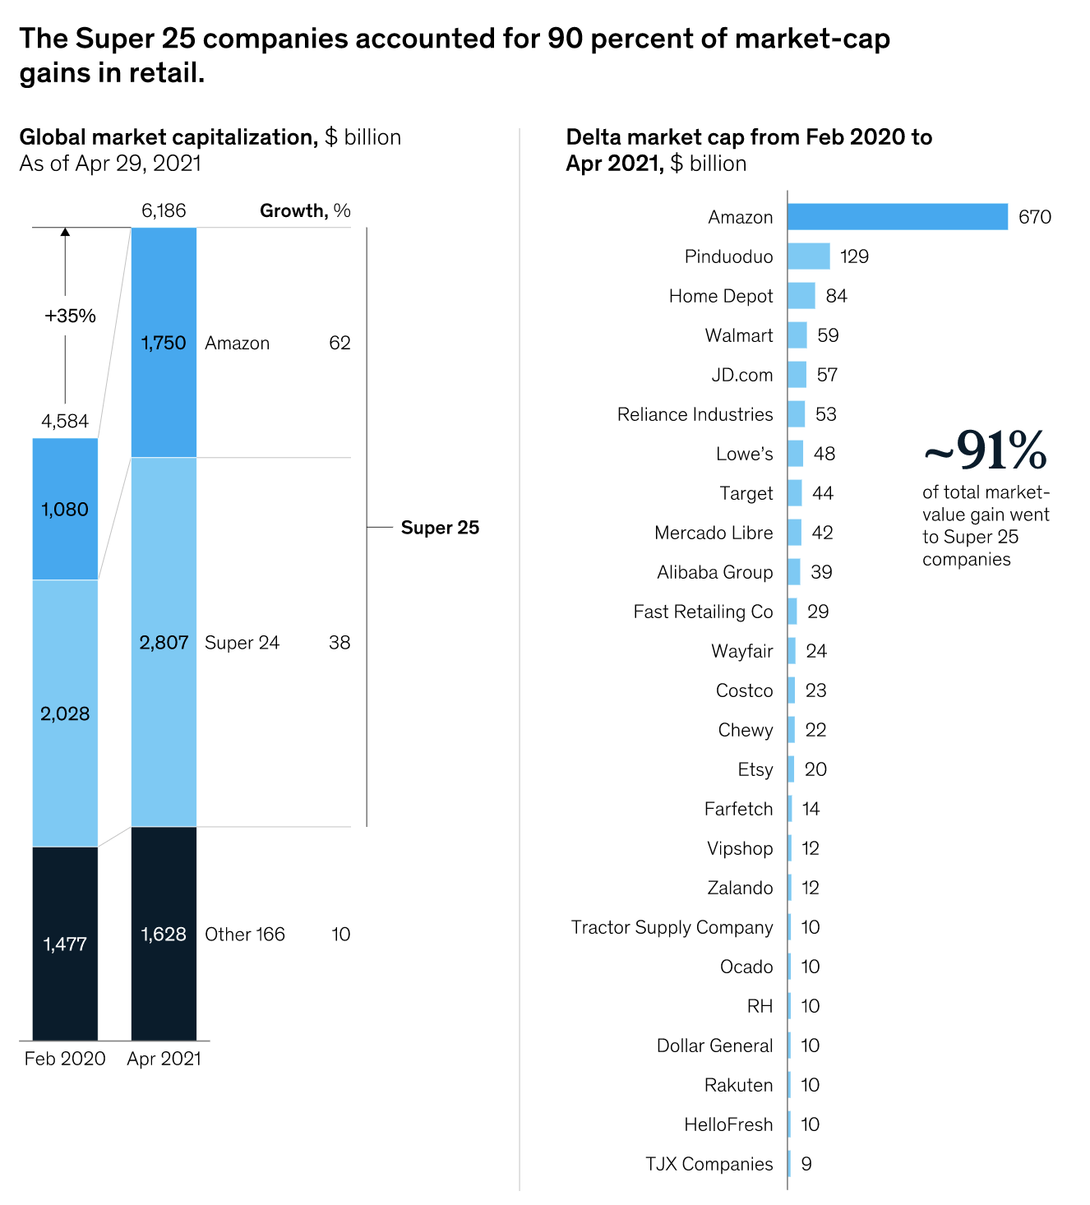


Executive Summary
Offline retail was declining
Stores had to shut down due to government health and safety measures
Stores closure further magnified the disappointing result of Q4 2019 revenue
Online traffic was not leading to conversion
People was at home, so they didn’t buy as much
Fulfillment of online order slows because of the impact of the pandemic (reduced staffing, physical distancing, warehouse closing, etc.)
Source: https://www.mckinsey.com/industries/retail/our-insights/why-retail-outperformers-are-pulling-ahead

Slide 5
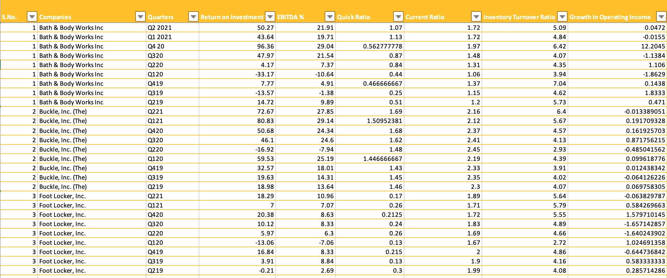
Data Overview
Tested for 36 Public companies from the Retail Sector that are Active (SIC – 56) in the United States
Extracted 17 variables including Ratios and elements from financial statements
Data Ranges from Quarter 2, 2019-Quarter 2, 2021
Created a timeseries format for the data

Slide 6
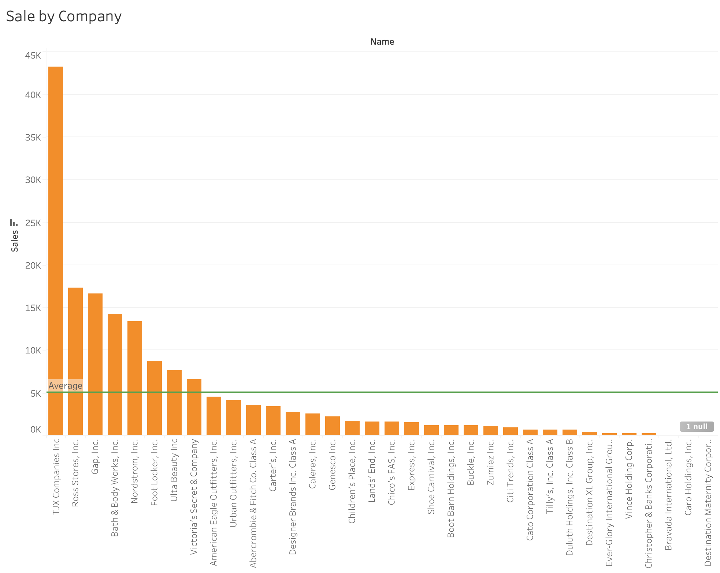
Data Exploration
Notes:
For the data exploration, first of all, we put the sales of the companies to a barchart, showing the top company with slaes, second, we break the companies by quartiles and assign the top company to 5 and 1 is the smallest ones. After that we all the total to have the overview of the companies base on the higher nu ber, better performance

Slide 7
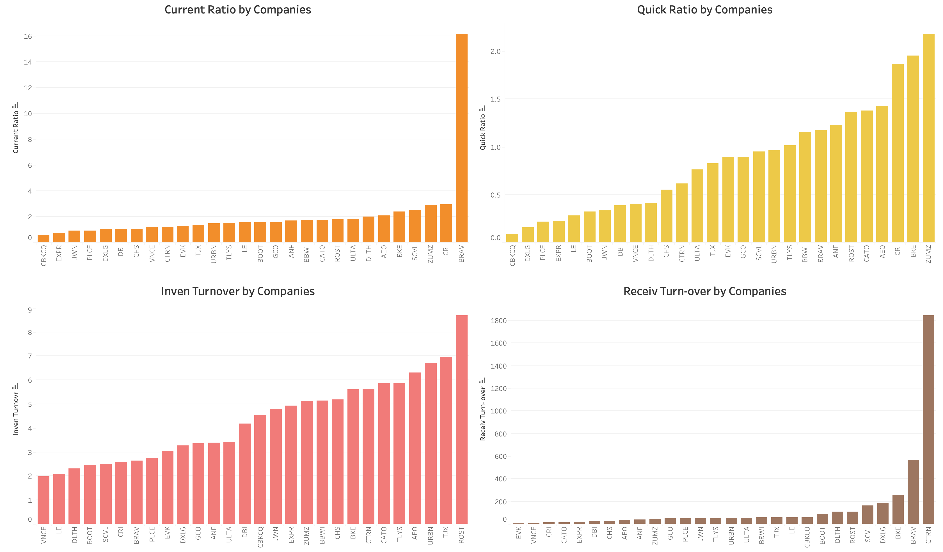
Data Exploration

Slide 8
Data Analysis - Hypothesis
Null hypothesis: Companies that adapted to the movement of demand and were cost-efficient should have increasing sales and better inventory turnover performance, and therefore, positive consumer opinions, during post-Covid period.

Slide 9
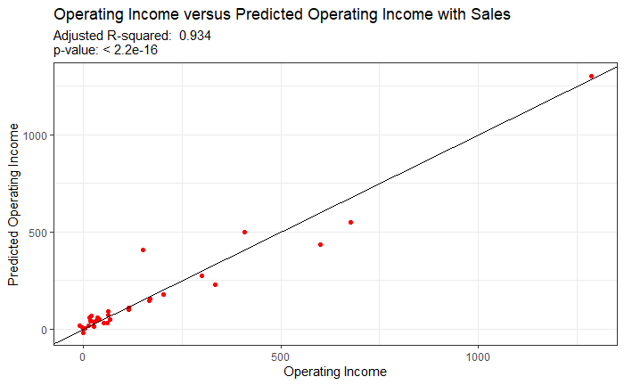
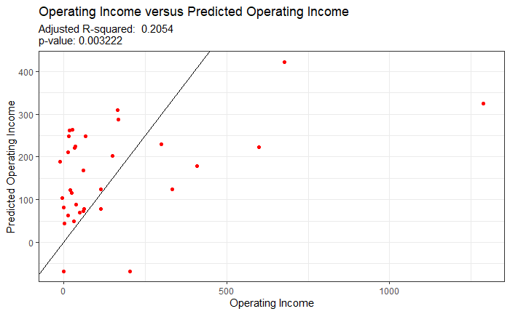
Data Analysis – Linear Regression Model
Linear Regression Model
Omit Sales because it is a one-to-one predictor​
Inventory Turnover Ratio as the predictor to Operating Income
High p-value indicates that there is not enough evidence that faster inventory turnover positively affects operating income.
Low Adjusted R-squared means high variability, showing that there are additional factors that affected the operating income of the

Slide 10
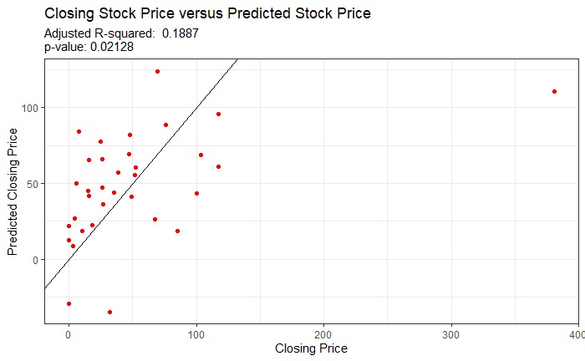
Data Analysis – Regression Model
Operating Income, Net Income Margin, and Net Cash Flow from Operating Activities are all predictors to the Stock Price, which represents public sentiment towards company performance

Slide 11

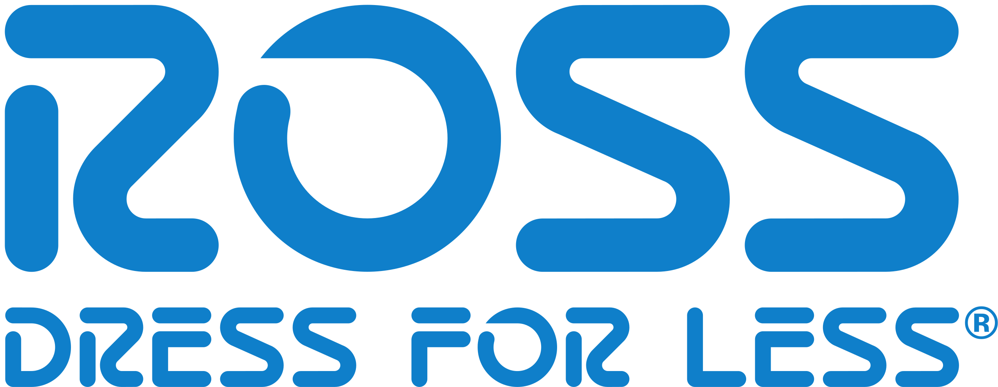



Case Studies
Top 5 companies that did well during the pandemic based on sales
Why they did well
TJX & Ross
High-cost reduction pre-vaccine rollout
Shut down e-commerce to fulfill in person orders
Focus on home goods rather than fashion
Focus on in person experience (touching before buying)
Nordstrom & Gap
Paused inner city operations during Covid
Closed stores and focus on online services
Launch luxury athleisure and intimates
Bath & Body Works
Leverage demand for hand sanitizer, soap, body care, and home fragrances
Promote “Me time” and time spend at home
Notes:
TJX/Ross:
High cost reduction: Shut down e-commerce to fulfill in person orders because the items the carries were affordable items
Open with safety restrictions (meaning focusing on customer comfort)
Focus on “normal” experiences (touching before buying) to appeal to the need for normality that everyone was craving
Nords/Gap:
Cut back on retail operations in inner city and move online + bringing the inner city stores back after vaccination
Focus on online services such as AR to see if clothing fits w/o trying them on in person
Bath & Body
^^ above

Slide 12

Companies that should have done well but didn’t.
Christopher & Banks Corporation (CBKC) was a specialty women’s apparel retailer founded in 1956
Despite having an Inventory Turnover of 4.5, their Operating Income was only –10.4
The Current Ratio of 0.6 was the lowest out of the companies we analyzed. This indicates a higher risk of distress or default.
In February of this year, Christopher & Banks Corp. Reached an agreement to sell all its assets, including its retail stores and e-commerce business, for $24.6 million.
Keri Jones, Christopher & Banks CEO, said the impact of the pandemic on retail sales forced the sale. The company reported a $10 million net loss in the third quarter and a 22% decline in sales from the same period a year earlier.

Slide 13
Conclusion
Reject the Null Hypothesis: Companies need a well-balance between making the demand and focusing on cost-cutting depending on their current cash flows and their ability to reduce the time to receive the payment.
Luxury Good Retailers
Discount Good Retailers
Retail companies whose main focus are luxury goods should invest into reducing digital friction within their online presence, pioneering AR visualizations, and last mile delivery optimization
Retail companies whose main focus are discount goods should invest into improving safety and experience within their in-person locations while reducing their online footprint ​

Slide 14
Recommendation
Focus on high-cost reduction for stores carrying affordable items
Focus on Quality of life / AR visualizations services for stores carrying luxury goods
Invest in logistics and supply chains to support shipping and widen the product ranges
Improve the convenience and time savings factors of services by removing Digital Friction
Build brand loyalty through rewards program even during time of hardship
Consider making a big pivot if a tailwind is lacking

Slide 15
Future Analysis Needed
Future Analysis needed on advertising, R&D, and marketing spending overall Pandemic
Further Due Diligence needed on international brands reaction to Pandemic and Vaccine Measures
Further Modeling on profitable and healthy companies between pre and post vaccine rollout
Notes:
Build brand loyalty through rewards program even during time of hardship

Slide 16
Thank You!
Team: Data Dragon
An Ngo | Andrea Ngo | Justin Nguyen
Medhavi Jain | Tram Le | Zion Taber

Slide 17
Citation
https://www.yahoo.com/now/10-industries-impacted-most-covid-110042511.html?guccounter=1
https://www.mckinsey.com/industries/retail/our-insights/why-retail-outperformers-are-pulling-ahead
https://www.statista.com/topics/6143/coronavirus-covid-19-impact-on-the-retail-landscape-in-the-us/#dossierKeyfigures
https://www2.deloitte.com/us/en/pages/consumer-business/articles/retail-recession.html
https://www.retailwire.com/discussion/nordstrom-aint-what-it-used-to-be-before-the-pandemic/
https://www.wsj.com/articles/coronavirus-changed-everything-except-t-j-maxx-11592818200
https://www.businessinsider.com/bath-and-body-works-sales-are-booming-amid-the-pandemic-2020-8
https://www.wsj.com/articles/gap-ceo-predicts-peacocking-effect-as-people-emerge-from-covid-19-pandemic-11614892544
https://www.mckinsey.com/industries/retail/our-insights/adapting-to-the-next-normal-in-retail-the-customer-experience-imperative
https://www.swissre.com/institute/research/topics-and-risk-dialogues/health-and-longevity/covid-19-and-consumer-behaviour.html
https://www.bizjournals.com/twincities/news/2021/02/01/christopher-banks-agrees-to-sale-for-246-million.html

